Slide 1
Building an automated ETL pipeline for Online Shopping Sales Data warehouse
Name : Saranya Karthick

Slide 2
System Architecture
Source: Local CSV files processed by a Flask API (api.py).
Orchestration: Airflow running in Docker containers.
ETL Logic: Python-based modular scripts (extract, transform, load).
Storage: PostgreSQL Data Warehouse managed via pgAdmin.
Visualization: Power BI

Slide 3
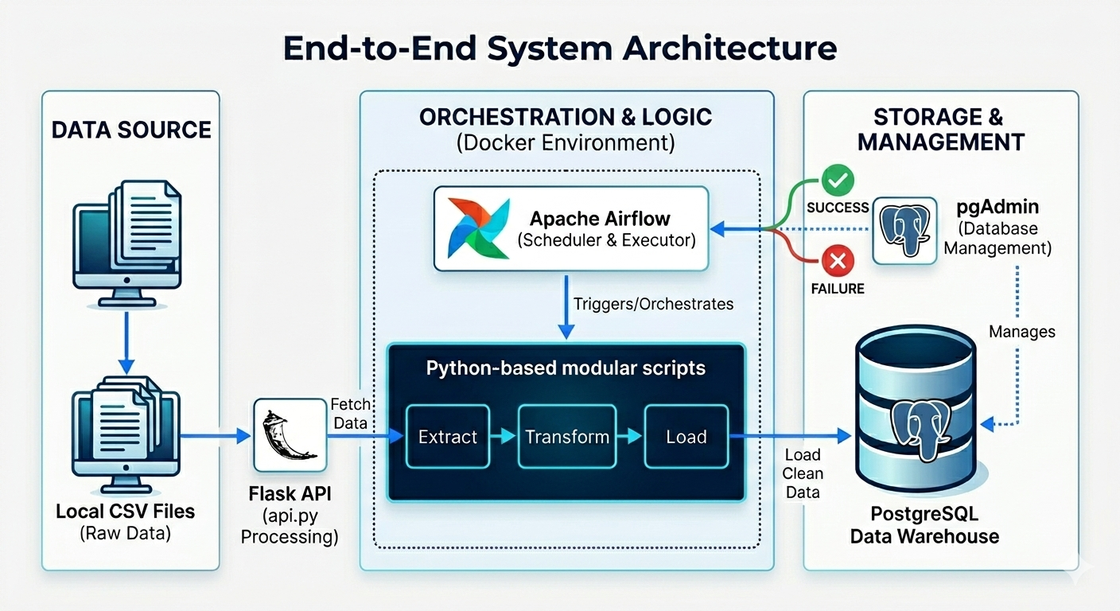
System Architecture

Slide 4
ETL-Extract
Developed a Flask-based API to serve as the data source for the ETL pipeline.
The API reads raw sales CSV files from a local directory.
Exposes an endpoint: http://127.0.0.1:5000/sales/csv

Slide 5
ETL-Transfrom
Data cleaning is performed:
Converted discounted_price, actual_price, rating, rating_count into numeric format.
Removed unwanted symbols from price columns.
Replaced missing values:
category_id → -1
user_id → "UNKNOWN"
user_name → "UNKNOWN"
A new calculated column is created:
A date_key column is added (current date) to support time-based analysis.
discount_amount = actual_price - discounted_price

Slide 6
ETL-Load
The cleaned data is loaded into PostgreSQL.
A Star Schema model is used.
Dimension tables are loaded first to generate surrogate keys.
ON CONFLICT DO NOTHING is used to avoid duplicate records.

Slide 7
Datawarehouse Schema
Fact Table:
fact_product_review
Dimension Tables:
dim_date
dim_category
dim_user
dim_product

Slide 8
Airflow
DAG Name: sales_etl_pipeline.
Schedule: @daily.
Task Flow: run_full_etl: A PythonOperator that triggers the run_pipeline() function from main_etl.py.

Slide 9
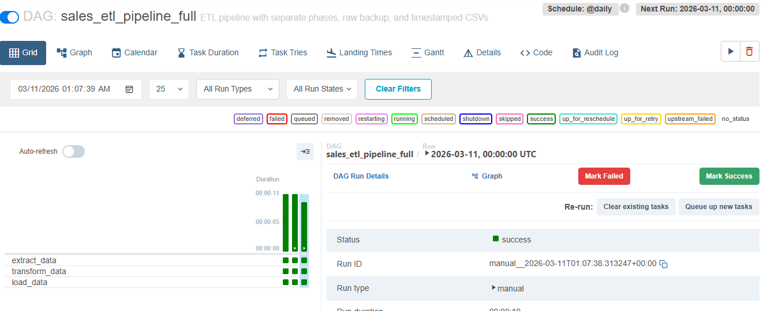
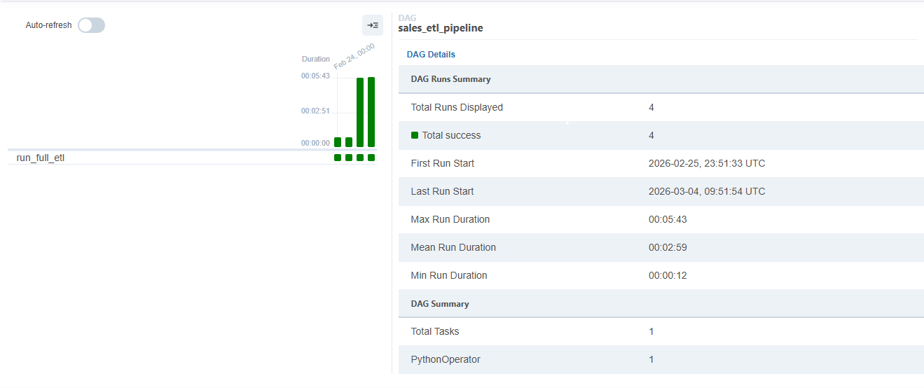
Airflow-sales_etl_pipeline

Slide 10
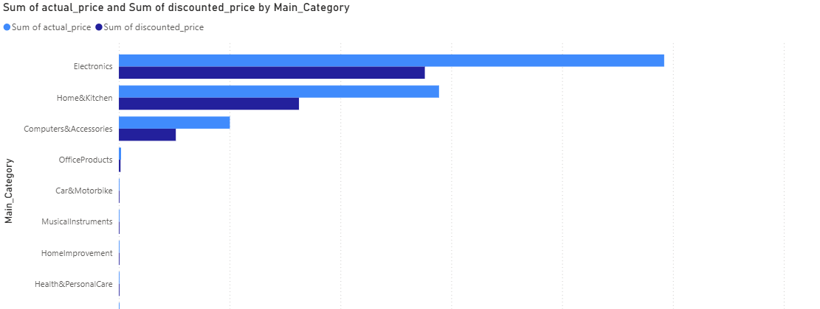
Visualization - Actual Price vs Discounted Price

Slide 11
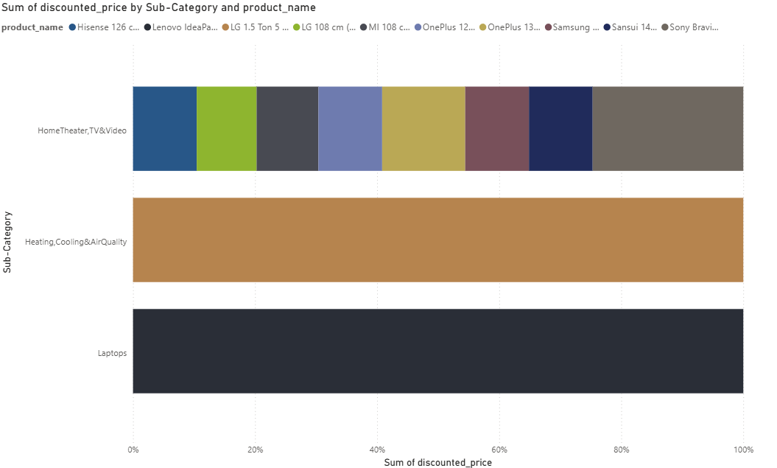
Visualization-Revenue by Category & Product

Slide 12

Future work
Automated Status Alerts: Set up automatic Email or Slack notifications to replace manual monitoring sending a "Job Success" summary daily and an immediate "Urgent Alert" if the pipeline fails.

Slide 13
Thank you

